Slide 1
C++
Selection

Slide 2
Last week operator precedence
Your presentations
Quiz / puzzles

Slide 3
Sequencing, Selection & Iteration
Sequencing: This means that the computer will run your code in order, one line at a time from the top to the bottom of your program. It will start at line 1, then execute line 2 then line 3 and so on till it reaches the last line of your program.

Slide 4
Selection
Selection: Sometimes you only want some lines of code to be run only if a condition is met, otherwise you want the computer to ignore these lines and jump over them. This is achieved using IF statements. e.g. If a condition is met then lines 4, 5, 6 are executed otherwise the computer jumps to line 7 without even looking at line 4,5 and 6.

Slide 5
Iteration
Iteration: Sometimes you want the computer to execute the same lines of code several times. This is done using a loop.
There are three types of loops:
For loops
While loops
Repeat until loops.
That’s handy as it enables you not to have to copy the same lines of code many times.

Slide 6
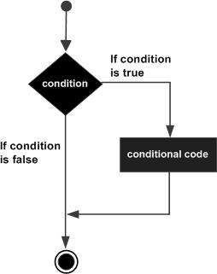
Selection
If (boolean_expression) {
// statement(s) will execute // if the boolean expression is true
}

Slide 7
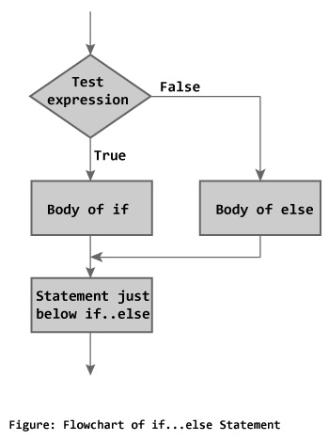
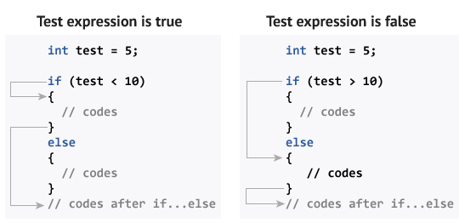
Execution flow

Slide 8
If cascade
if(i == 1) cout << "Only one?" << endl; else if(i == 2) cout << "I want more" << endl; else if(i == 3) cout << "Not bad" << endl; else cout << "OK" << endl;

Slide 9
Ternary operator
if (y < 10 ) {
x = 30;
} else {
y = 40;
}
x = (y < 10) ? 30 : 40;

Slide 10
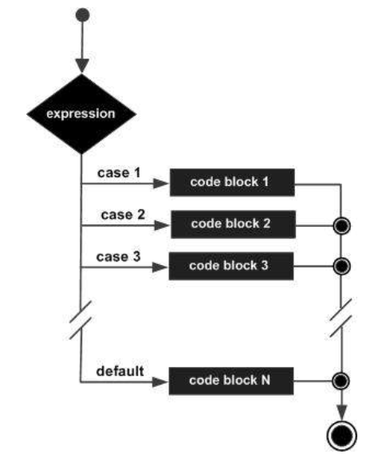
#include <iostream> using namespace std; int main () { char grade = ‘D’;
switch(grade) { case 'A’ :
cout << "Excellent!" << endl; break; case 'B’ : case 'C’ : cout << "Well done" << endl; break; case 'D’ : cout << "You passed" << endl; break; case 'F’ : cout << "Better try again" << endl; break; default : cout << "Invalid grade" << endl; } cout << "Your grade is " << grade << endl;
return 0; }

Slide 11
Switch fall through
This will be in the exam
Because it is tricky and hard to follow the logic
And it is a powerful way of coding
Some developers hate it

Slide 12
switch (value) { case 0: result = ZERO_DIGIT; break; case 1: case 3: case 5: case 7: case 9: result = ODD_DIGIT; break; case 2: case 4: case 6: case 8: result = EVEN_DIGIT; break; }
Fall through that is NON-EVIL

Slide 13
Evil
Can you fix evil switch fall throughs?
Maybe. You can use a
/* FALL THROUGH */
comment where the break would be expected.
Or use an if / else statement.
switch (x) { case 1: some code case 2: some more code case 3: even more code break; }
Intentional or bug?

Slide 14
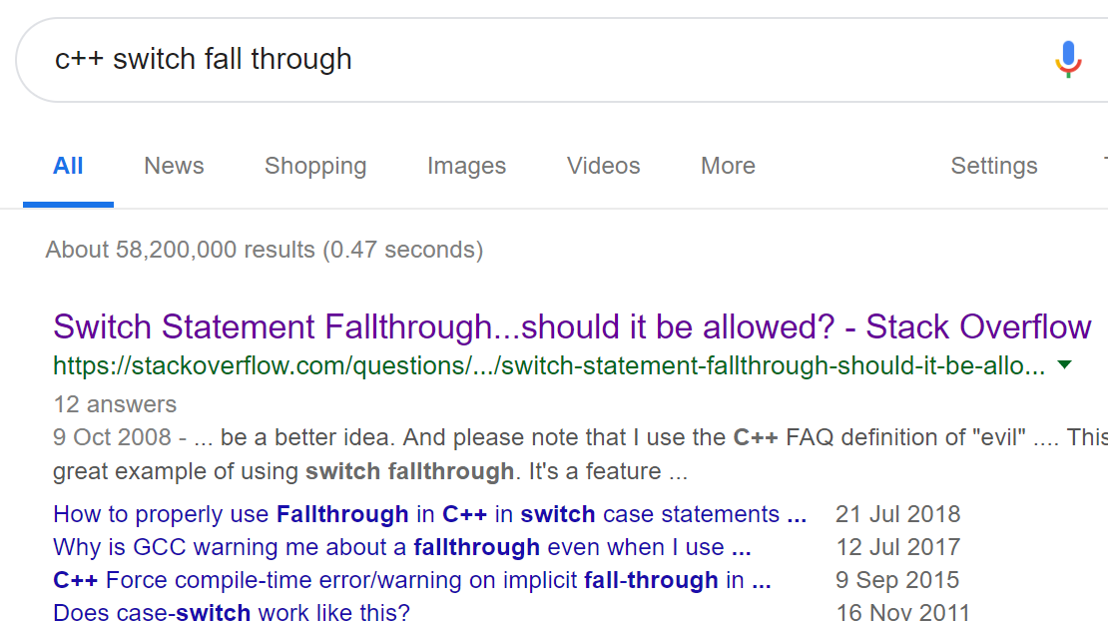
First result ☺ haha

Slide 15
Nested
You can nest an if statement inside an if statement
You can nest a switch inside a switch
Etc…

Slide 16
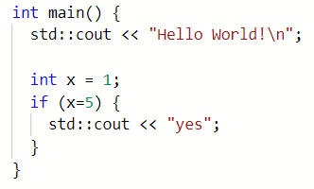
Quick quiz: What is output?

Slide 17


Slide 18
Common errors
Given that you will make this mistake, how do you defend against it?
You will make this mistake
We all make this mistake
if ( x=1 ) {
cout << “x is one”;
} else {
cout << “x is NOT one”;
}

Slide 19
Some notes for the assignment
Assignment – due in on Monday the 4th Feb
Worksheet
Formative

Slide 20
Some notes for the assignment
Assignment
Worksheet
Formative (lecture 13)

Slide 21
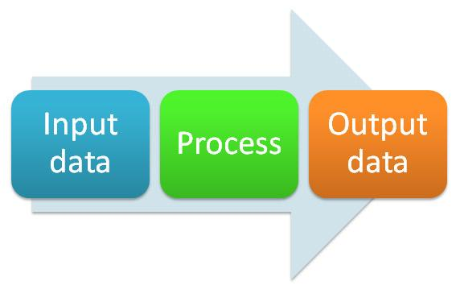
Input Process Output chart
What data items are input
What processing takes place on the data
What information will be the end result – the output

Slide 22
IPO chart
Input | Processing | Output
a | Enter first integer – a | Mean average
b | Enter second integer - b | Maximum number
c | Enter third integer - c
 | Calculate the mean
 | Calculate the maximum number

Slide 23
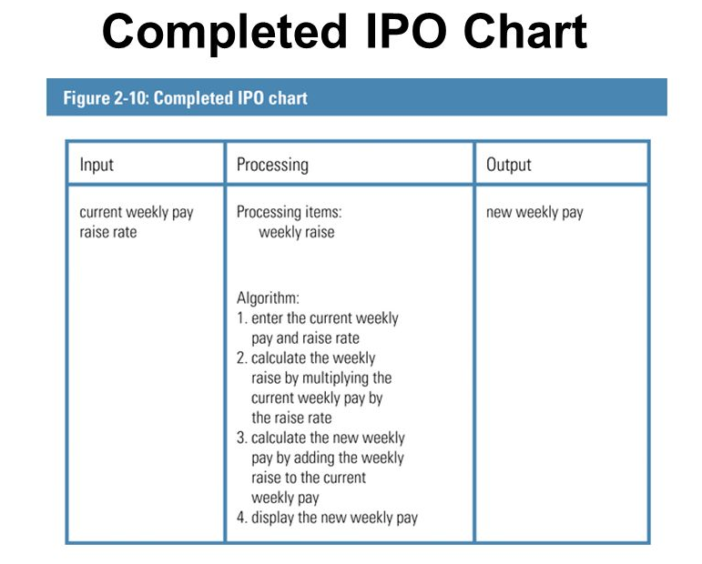

Slide 24
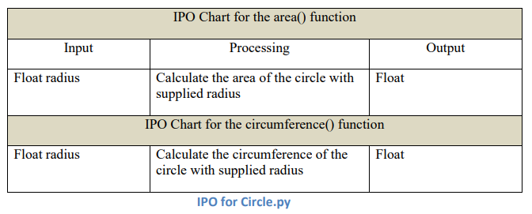

Slide 25
Some notes for the assignment
Assignment
Worksheet
Formative (see lecture 13)

